Slide 1
NBA Players Heights Over 25 Years
Jimmy Yu
M.S. in Business Analytics at Cal Poly Pomona

Slide 2
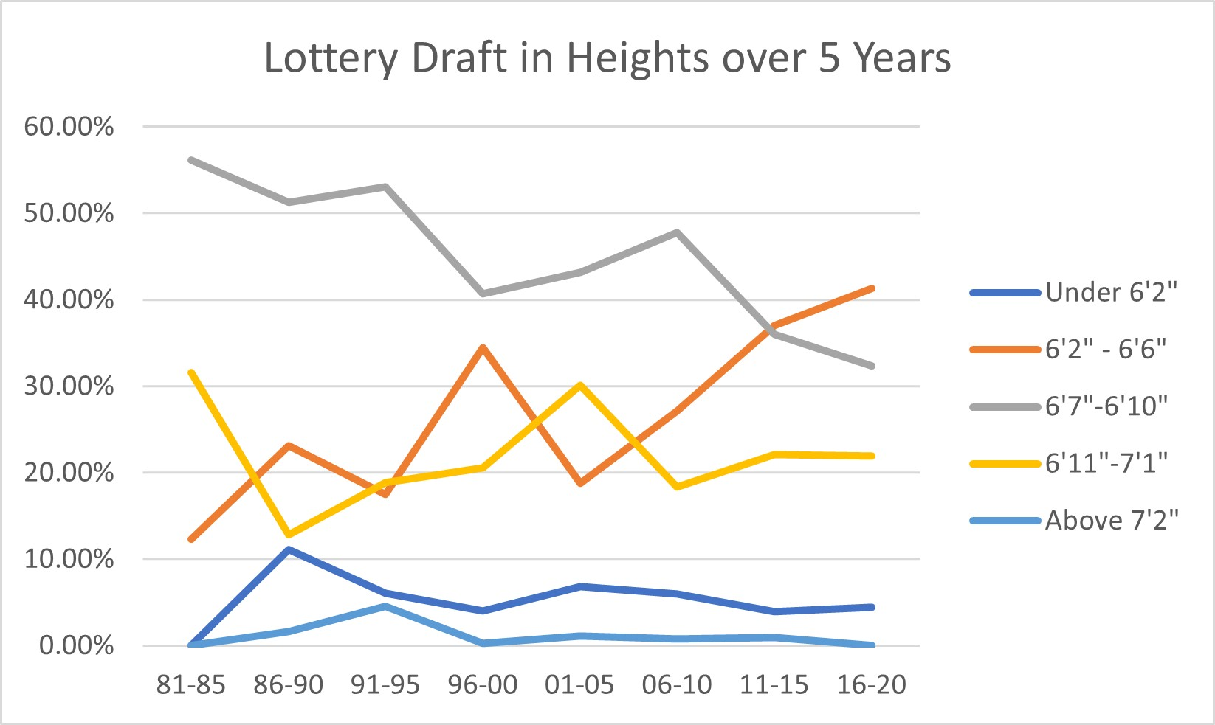
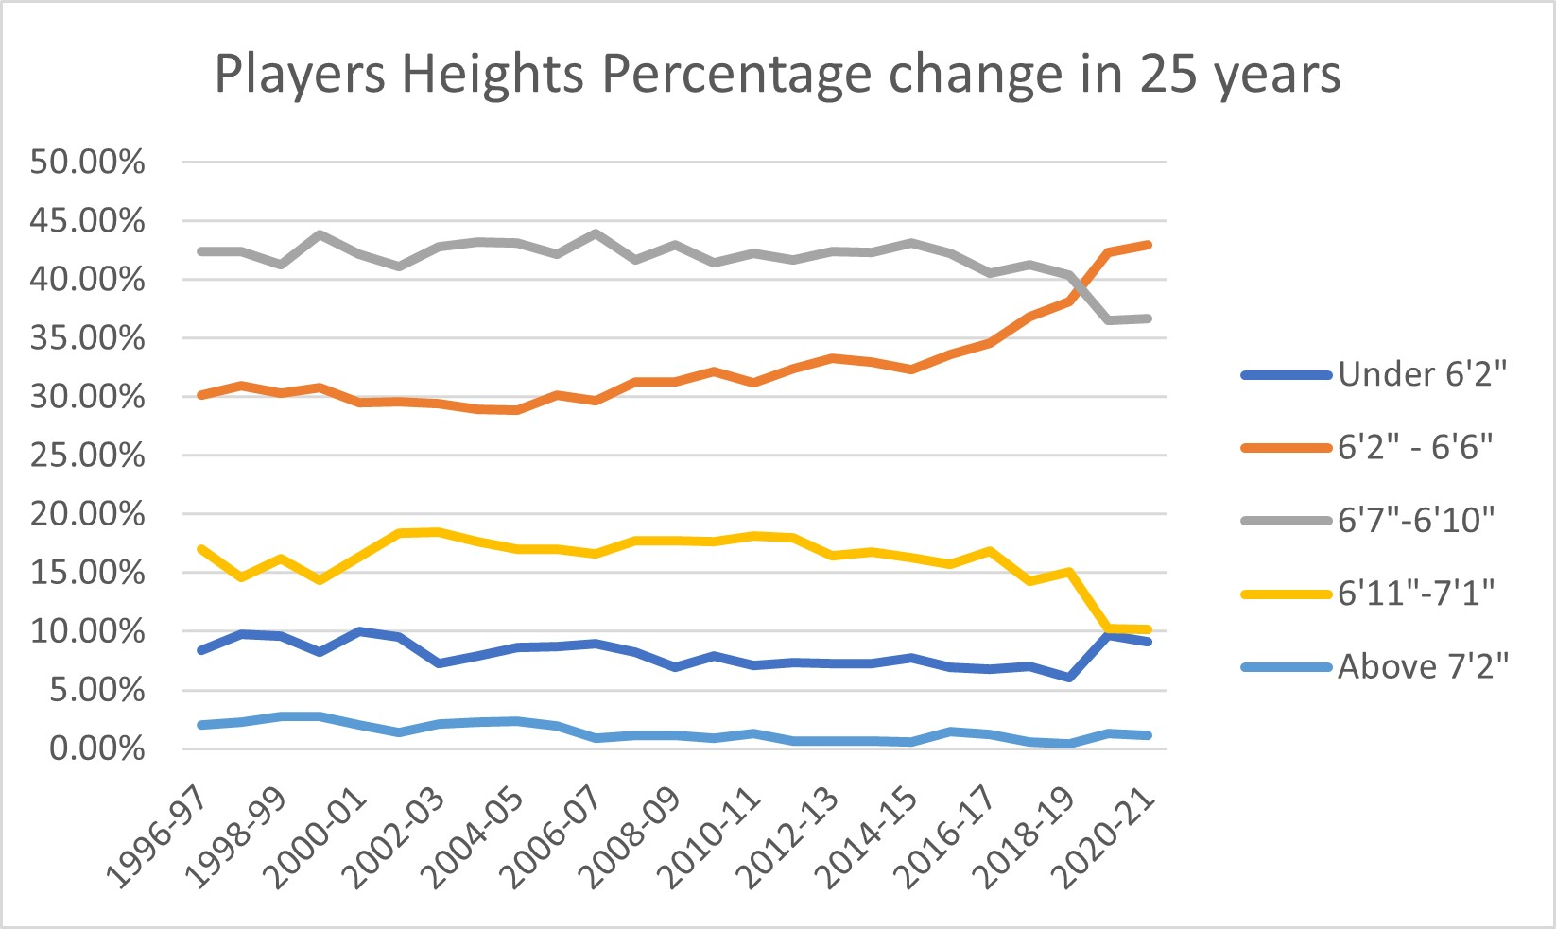
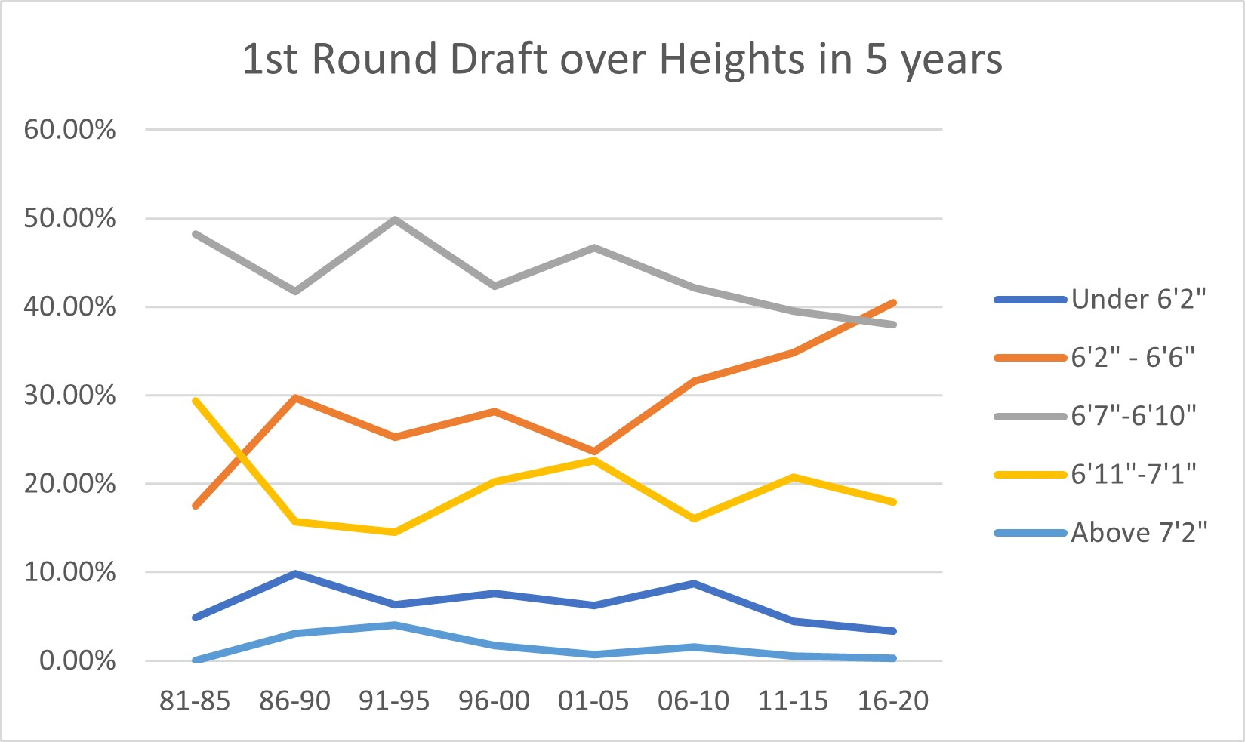
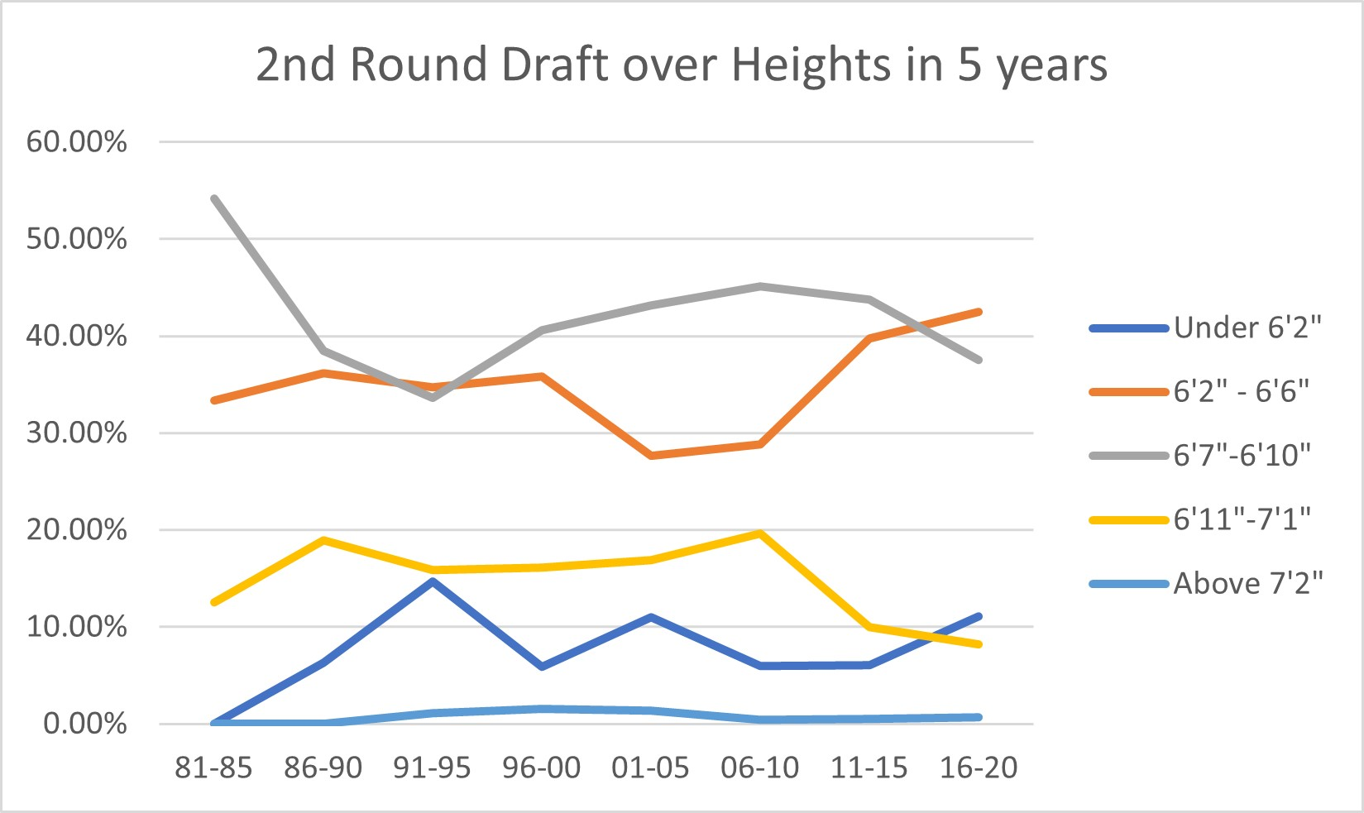
NBA Drafts on Heights in 5 years bins
Players under 6’6’’ are usually identified as “Guard” position.
6’2’’ – 6’6’’ players has significantly increased since 2010.
The earlier draft picks are, the more significant change in result.
6’7’’ – 6’10’’ players used to be the most popular heights to draft in the league. However, it has been replaced by 6’2’’ – 6’6’’ players.

Slide 3
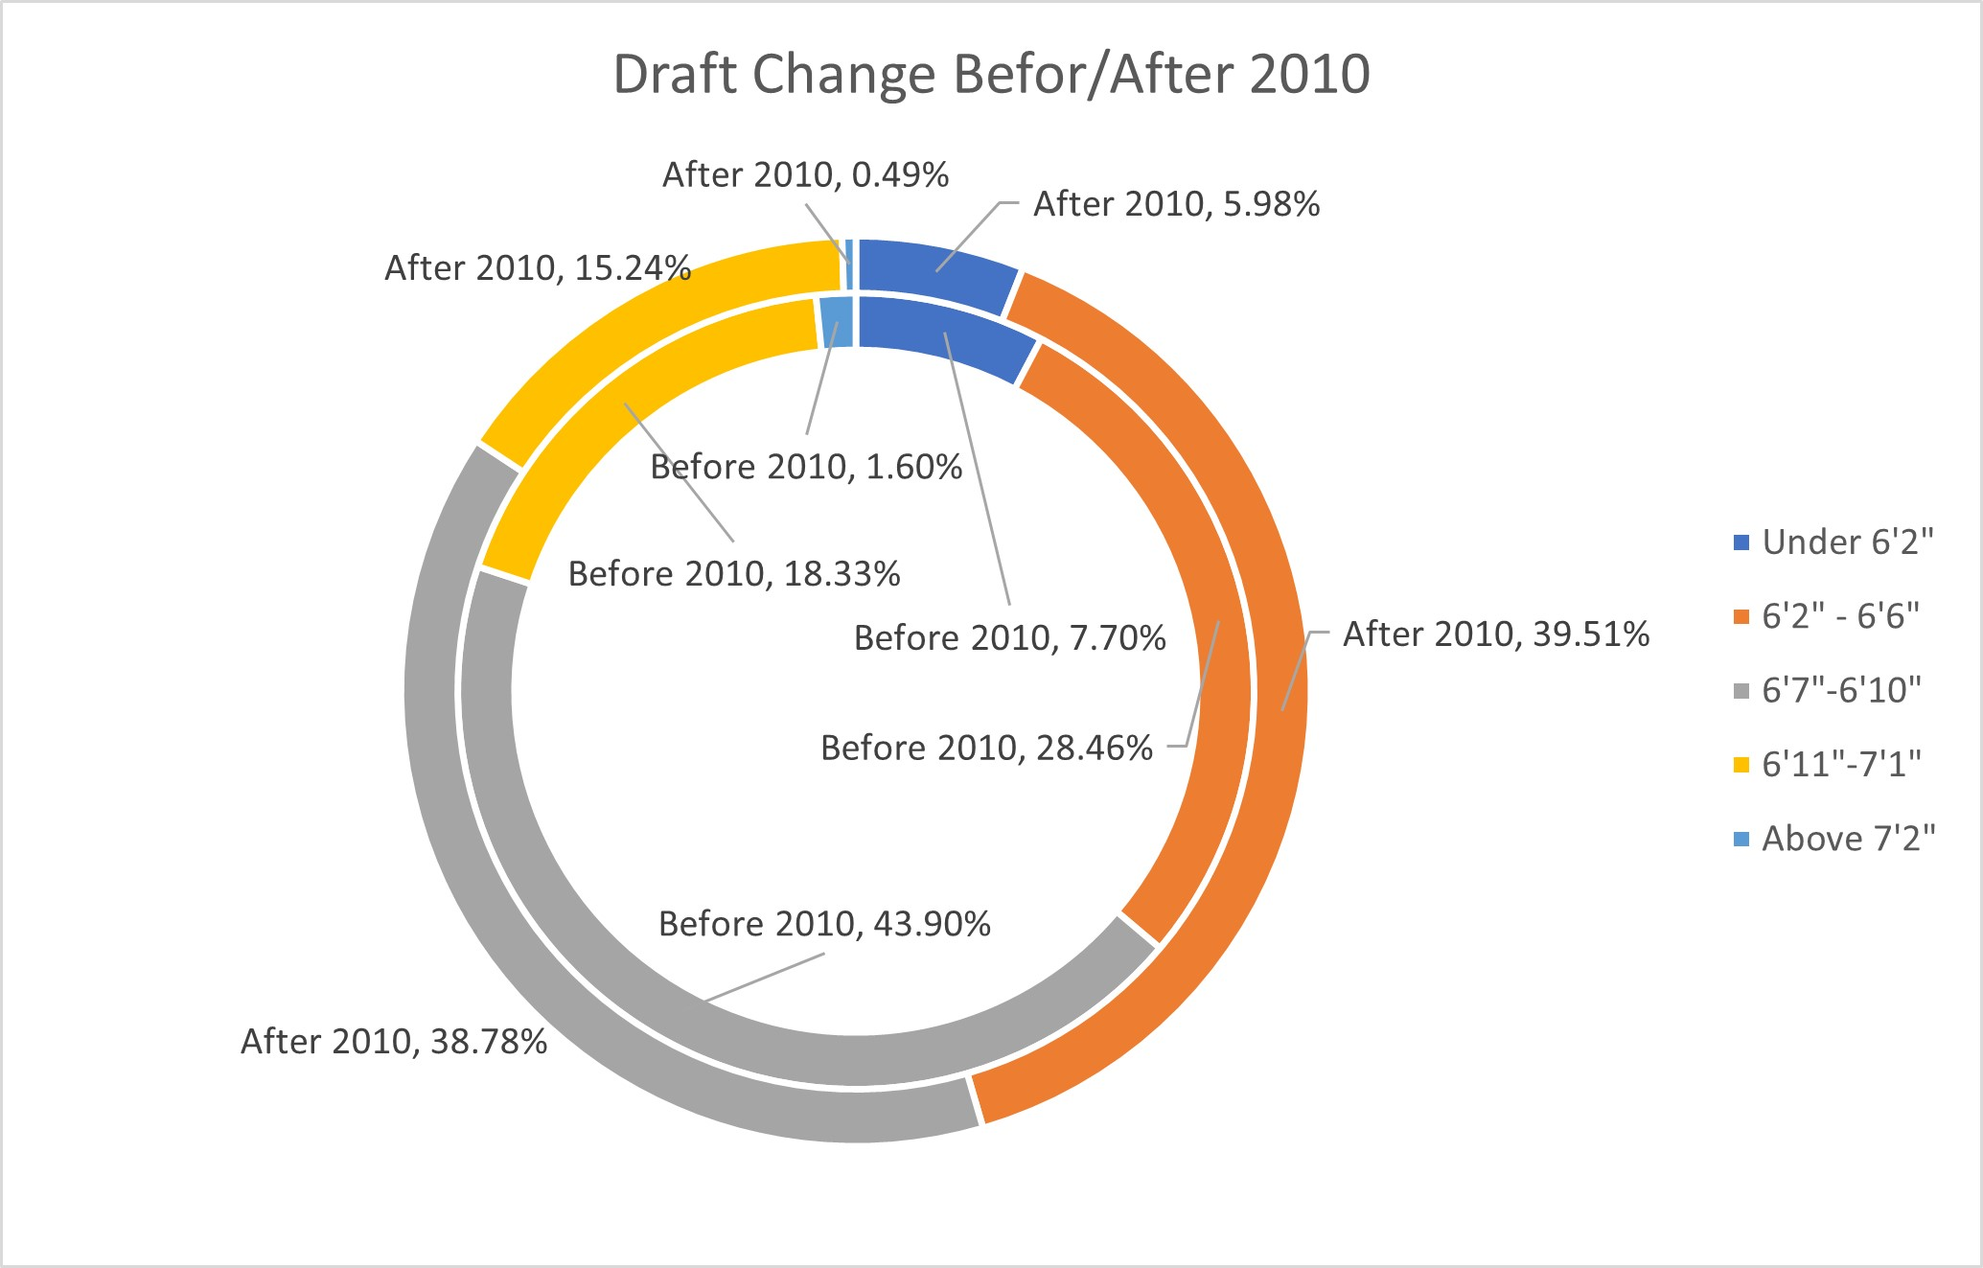
Draft Strategy Changed
6’7’’ – 6’10’’(forwards) players occupied almost half(≈44%).
6’2’’ – 6’6’’(guards) drafted players have increased 38% after 2010.
Guards became the most draft position after 2010 instead of forwards.
Players over 6’11’’(Centers) have decreased 21% after 2010.

Slide 4
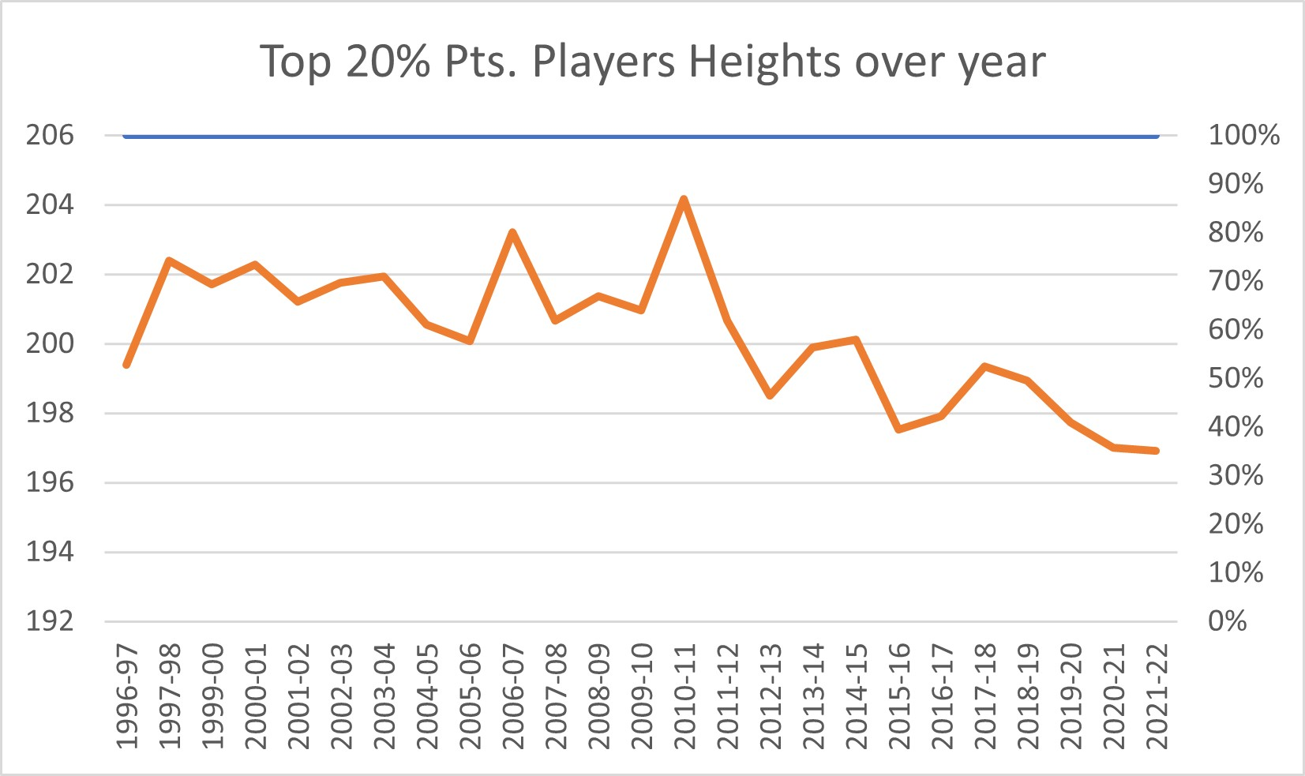
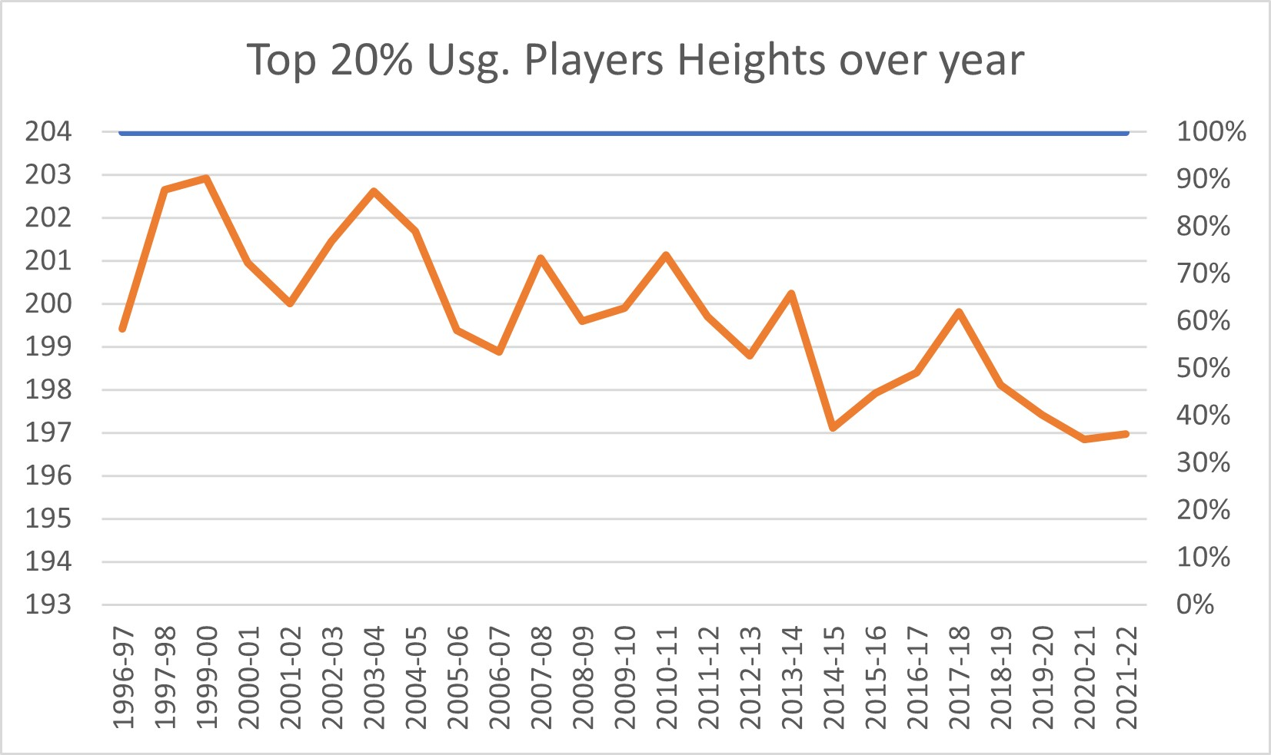
Tactical Focus Moving from Front to Back
Filtered out top 20% players to make sure only having players under the focus of team tactical.
Statistic drops dramatically from 2010 again. Especially on top 20% points players.
Have a peak of heights on 2010, might have something changed in real time during 2010 – 2011.
The top 20% usage player’s heights have a negative linear relationship over time.

Slide 5
Real Time Observe
Things happened around 2010
The tail of the prime of “Power forward era” (Kevin Garnett, Dirk Nowitzki, Tim Duncan and Rasheed Wallace)
Lakers with their 3 big guys (Pau Gasol, Andrew Bynum and Lamar Odom) had their last shine.
Shaq O’Neal got old, Dwight Howard injured/ traded, no other dominant centers stood out.
Lebron James brought his talent to Miami with Dwayne Wade and Chris Bosh, pace up the temple of games, which required mobility.
Kevin Durant join the league, playing guard with a center’s height.
Derrick Rose, Russel Westbrook, Stephen Curry, James Harden, Kyrie Irving just got into the league.
Things happened after 2010
2011 Derrick Rose honored as the youngest MVP of all time. Russel Westbrook became an All-Star.
2013 James Harden joined the Rocket and start running ball under statistic(Moneyball basketball version).
2014 Russel Westbrook, Kyrie Irving, John Wall and Damian Lillard start shining.
2014~ Golden State Warriors and Stephen Curry came out, the temple of the game get faster again.
DeAndre Jordan, Draymond Green became All-Stars by defense.
NBA start looking for “Unicorns” who can move fast but also tall.
Paul George, Anthony Davis, Kawhi Leonard and Kevin Durant in and out the injury list.

Slide 6
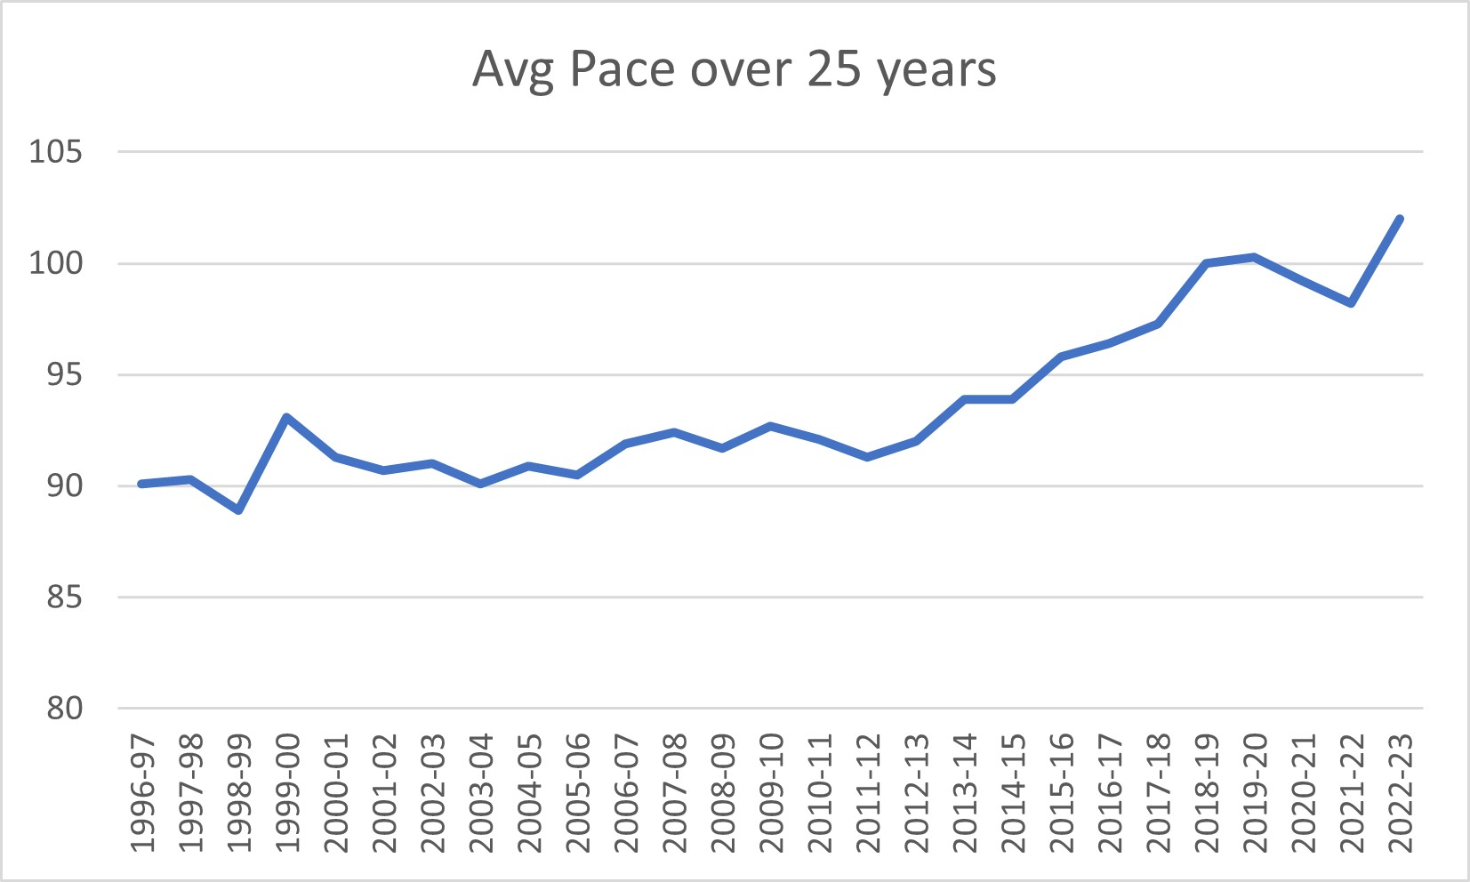
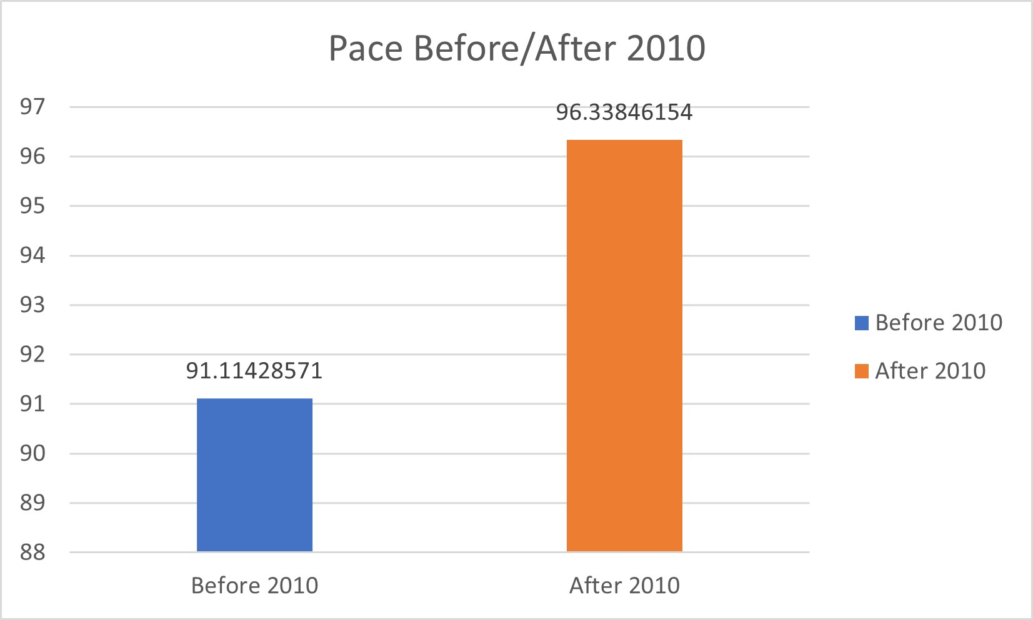
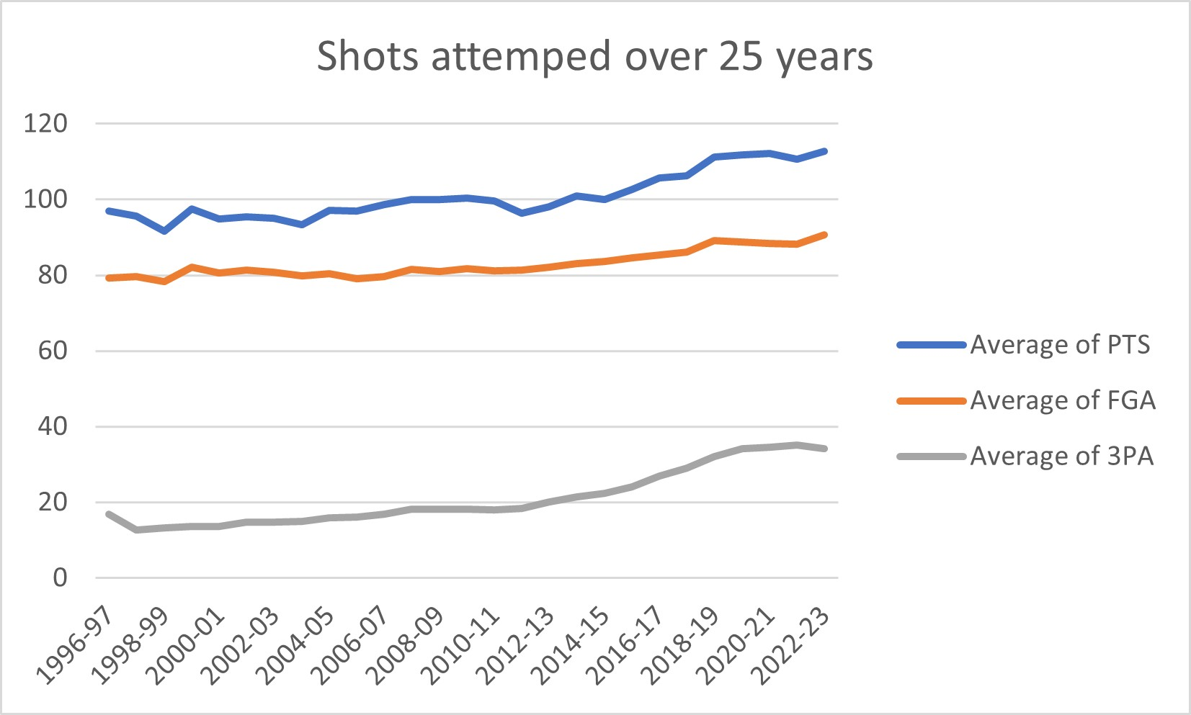
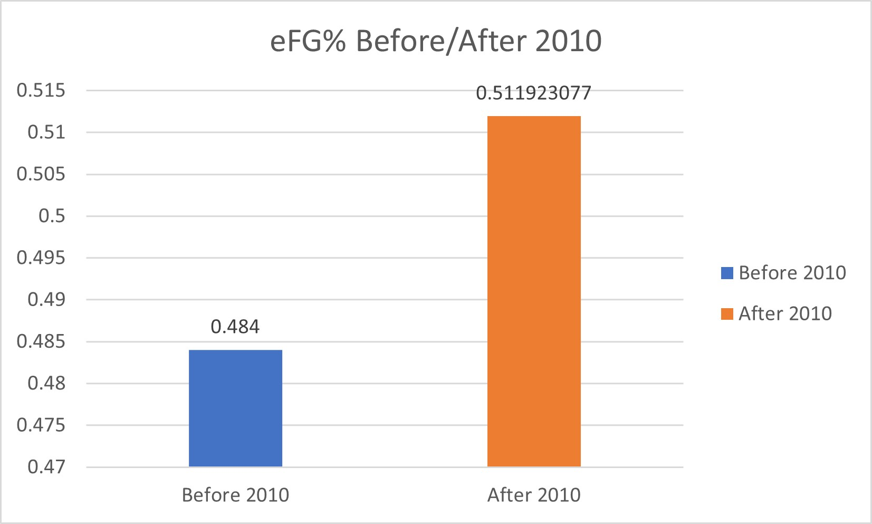
NBA Pace Changed over time
The slope of pace increased around 2011.
Slope of 3PA increased significantly around 2012.
Players shot more efficient after 2010.

Slide 7
Conclusion
NBA changed from a forward(6’7’’-6’10’’) focus composed to a guard focus composed.
NBA have paced up significantly since the early 10s.
The league prefer mobility more than length nowadays, and players with both are “Unicorn”.

Slide 8
Data Sources
https://www.kaggle.com/datasets/justinas/nba-players-data
https://www.basketball-reference.com/leagues/NBA_stats_per_game.html

Slide 9
Thank You!

